Slide 1
Pivotal Cloud Foundry
Jan 2017

Slide 2
PCF -DAY 03

Slide 3
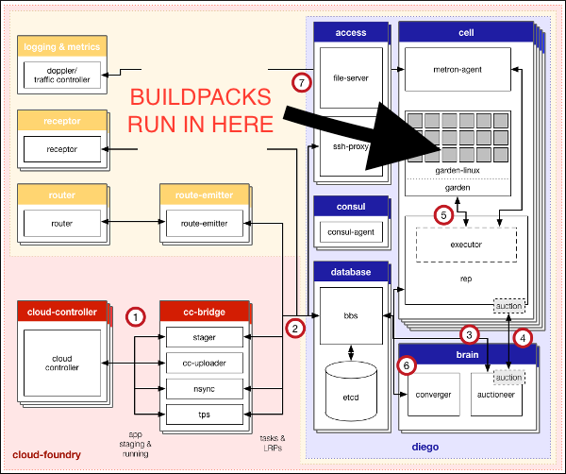
Buildpack

Slide 4
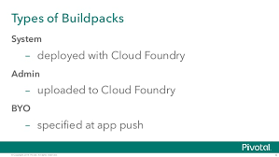
Buildpack
Buildpacks provide framework and runtime support for your applications.
Buildpacks typically examine user-provided artifacts to determine what dependencies to download and how to configure applications to communicate with bound services.
When you push an application, Cloud Foundry automatically detects which buildpack is required and installs it on the Diego cell where the application runs.
During staging, each buildpack has a position in a priority list (identified by running cf buildpacks).
Cloud Foundry checks if the buildpack in position 1 is a compatible buildpack. If the position 1 buildpack is not compatible, Cloud Foundry moves on to the buildpack in position 2. Cloud Foundry continues this process until the correct buildpack is found. If no buildpack is compatible cf push fails.

Slide 5
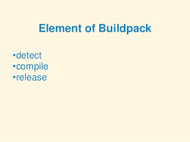
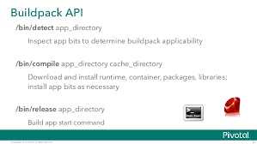
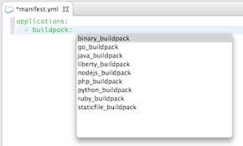
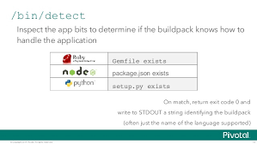
Buildpacks

Slide 6
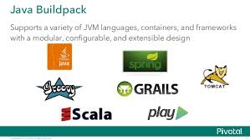
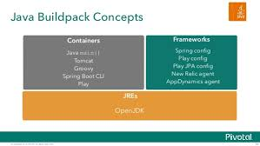
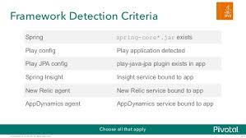
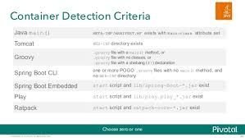
Java Buildpack

Slide 7
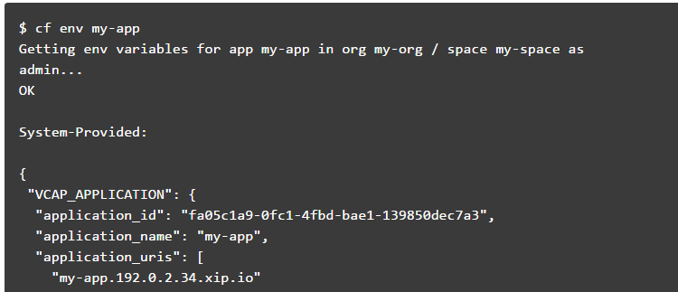
Cloud Foundry Environment Variables
Environment variables are the means by which the Cloud Foundry runtime communicates with a deployed application about its environment.
View Environment Variables

Slide 8
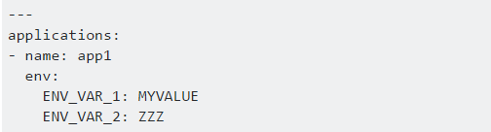
Cloud Foundry Environment Variables
Setting env variable via CF CLI
E.g.
cf set-env APP_NAME ENV_VAR_NAME ENV_VAR_VALUE
Reverting the env variable
E.g.
cf unset-env APP_NAME ENV_VAR_NAME
In addition, you can set environment variables in an application manifest file.

Slide 9
Cloud Foundry Environment Variables
VCAP_SERVICES
The VCAP_SERVICES environment variable is a JSON object that contains information that you can use to interact with a service instance
The information includes service instance name, credential, and connection URL to the service instance. These values are populated into the VCAP_SERVICES environment variable when your application is bound to a service instance.
The value of the VCAP_SERVICES environment variable is available only when you bind a service instance to your application.
The service object contains a child object for each service instance of that service that is bound to the application.

Slide 10
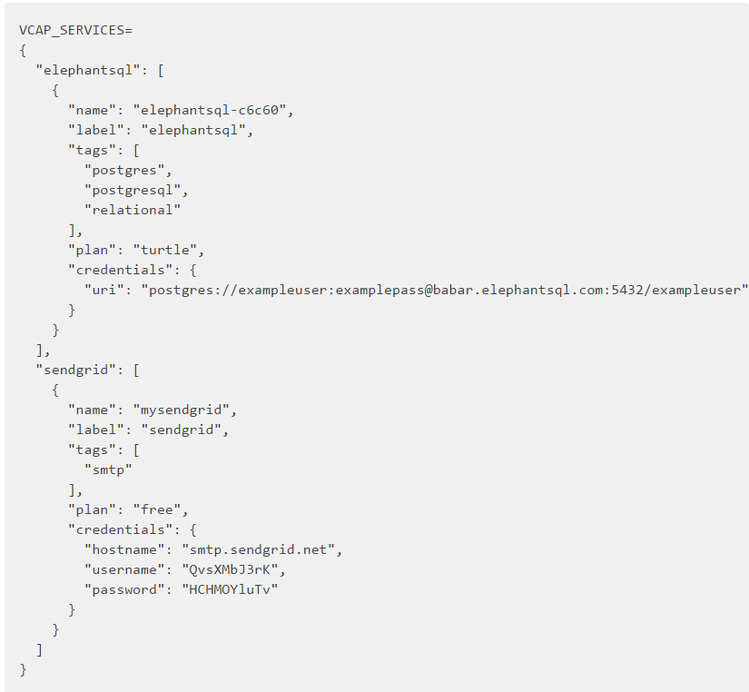
Cloud Foundry Environment Variables
VCAP_SERVICES
The example below shows the value of VCAP_SERVICES for bound instances of several services available in the Pivotal Web Services Marketplace.

Slide 11
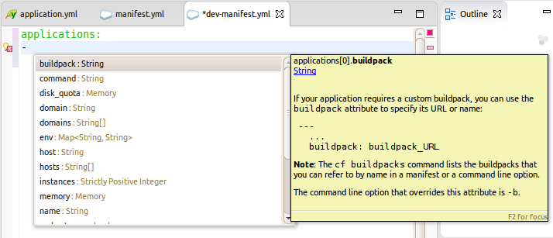
Manifest.yml

Slide 12
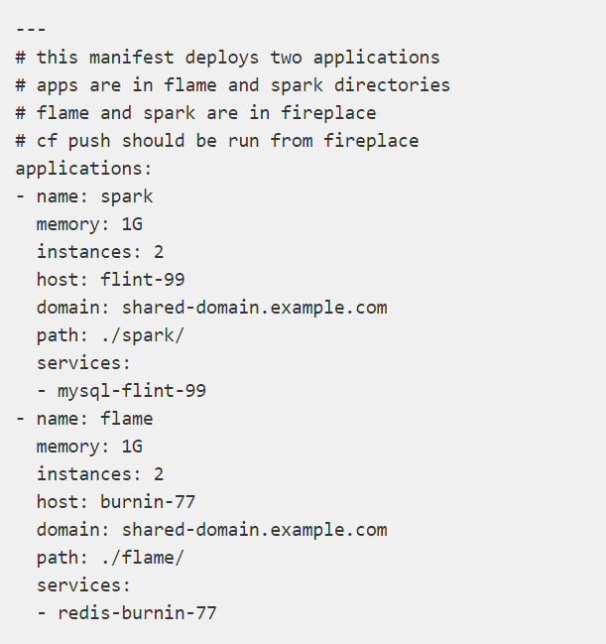
Sample Manifest file

Slide 13
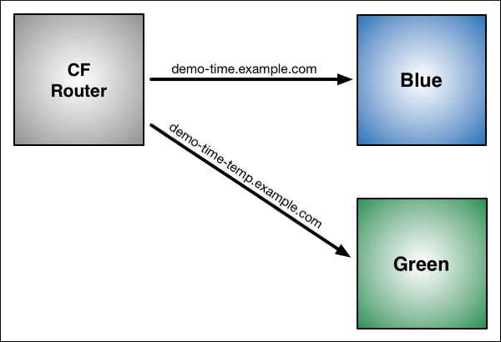
Blue-Green Deployment
Blue-green deployment is a release technique that reduces downtime and risk by running two identical production environments called Blue and Green.
At any time, only one of the environments is live, with the live environment serving all production traffic. For this example, Blue is currently live and Green is idle.
Notes:
Notes:
If your app uses a relational database, blue-green deployment can lead to discrepancies between your Green and Blue databases during an update. To maximize data integrity, configure a single database for backward and forward compatibility.
You can adjust the route mapping pattern to display a static maintenance page during a maintenance window for time-consuming tasks, such as migrating a database. In this scenario, the router switches all incoming requests from Blue to Maintenance to Green.

Slide 14
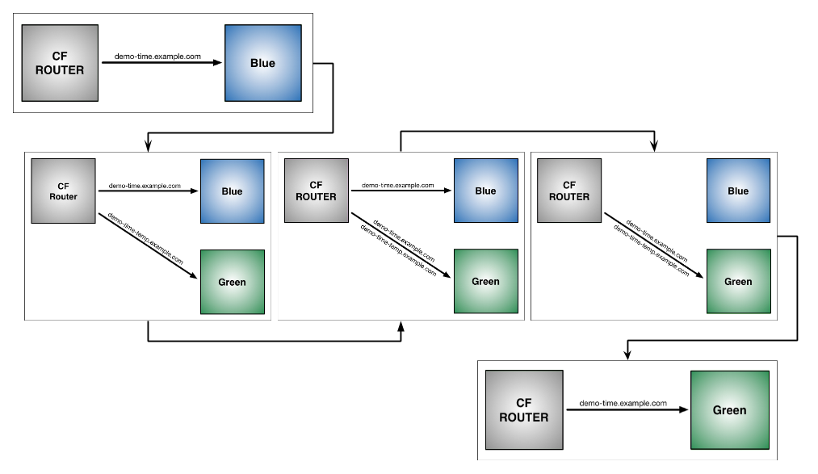
Blue-Green Deployment

Slide 15
Lab03

